Slide 1
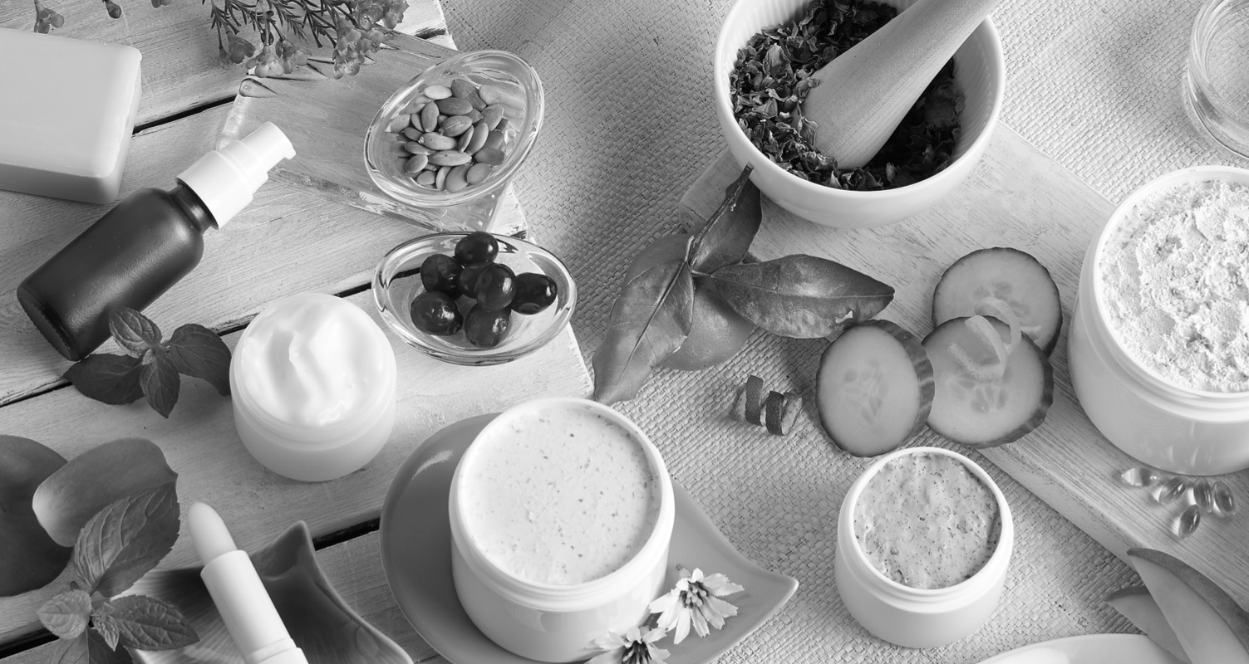
Natural Skin Care Trusted For Generations

Slide 2
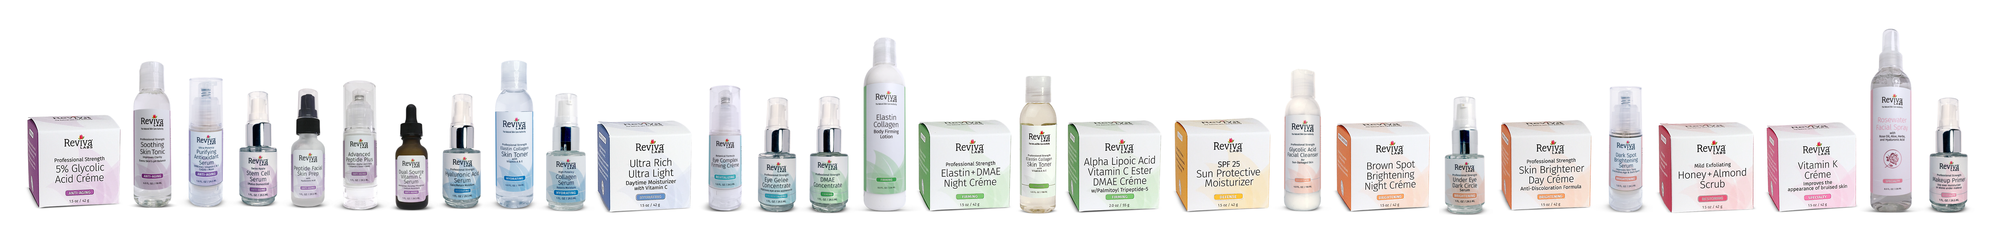

A History of Great Natural Skin Care
Reviva Labs was established by Steven Strassler in 1973. As one of the first licensed aestheticians in the United States, Mr. Strassler combined his training with his interest in natural ingredients to create a new approach to skincare – a line of individual products for individual skin care needs.
For the next 45 years, Reviva Labs has continued to be at the forefront of the natural skin care industry - formulating natural solutions to individual skin care need and pioneering innovations and “firsts” such as a non-chemical exfoliation (Light Skin Peel), the use of topical trace minerals as a catalyst for absorption, promoting the use of Elastin in the US, combining Hyaluronic Acid and Glycogen for a new ‘Intercellular’ approach in skin care and much more.
And, we’re not slowing down anytime soon!

Slide 3
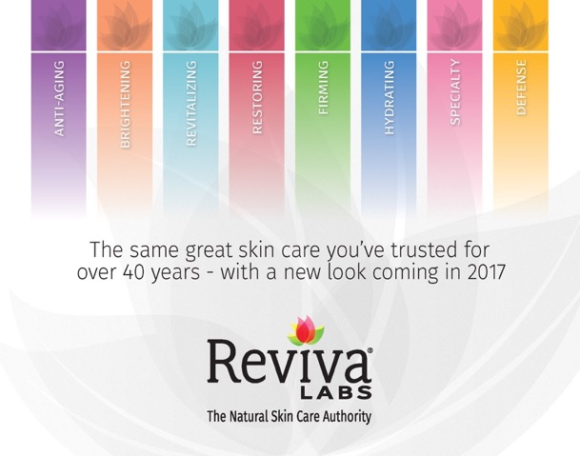
Making Natural Skin Care Even Easier
What sets us apart:
Solution based skincare
Reviva products are organized into easy to identify ‘categories of concern’ with compatible skin types clearly indicated on the packages
Concept of layering
Reviva products are designed to work synergistically to enhance and effectively address multiple concerns and skincare needs.
Decades of experience launching innovative ingredients
Reviva Labs has a history of being first to market with new and effective skincare ingredients that work. Each formula undergoes extensive review and testing before being introduced: skin sensitivity, stability, effectiveness, and potency are all examined over the course of months (or years) during development.

Slide 4
Anti-Aging
Brightening
Defense
Firming
Our Anti-Aging collection focuses on keeping skin supple, wrinkle-free, and healthy. Peptides, antioxidants, firming ingredients, and moisturizers work together to nourish and rejuvenate your skin – delivering a naturally youthful complexion.
Reviva is well-known for the effectiveness of our Brightening collection. With ingredients proven to inhibit melanin production, our brightening products help reduce discoloration and even skin tone, leaving skin looking healthier and more radiant.
One of the most important parts of any skin care regimen is protection - from the sun as well as from other environmental factors. Reviva's Defense collection works to protect skin from the elements that can cause damage.
Skin that is tight and firm looks healthier and more youthful. With DMAE, antioxidants, Collagen, and Elastin, Reviva's Firming line helps lift sagging skin for a toned, firm look.
Hydrating
Restoring
Revitalizing
Specialty
Hydration is such an important part of any skin care routine, and Reviva's Hydrating collection contains ingredients such as Hyaluronic Acid, Collagen, and plant extracts to impart and maintain moisture in the skin.
As your body's largest organ, your skin is exposed daily to pollution, sun damage, and various toxins which can build up. Restoring your skin means removing dirt and toxins and replenishing vital moisture and nutrients.
Does your skin look or feel tired? Reviva's Revitalizing collection helps "wake up" your skin, energizing it with plant extracts and trace minerals to help skin look more radiant.
Reviva knows that no single product can be all things to all people - after all, everyone's skin is different. But that doesn't stop us from formulating products to address many different skin concerns. Our Specialty products address numerous skin care issues.

Slide 5
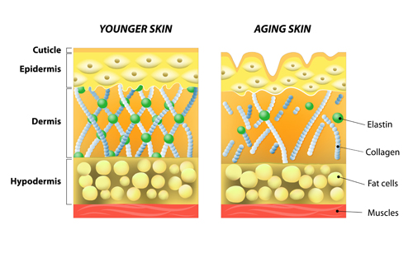
Skin 101 Review
The skin is the largest organ of the body:
Its major function is to:
Protect the body from environmental assaults
Prevent excessive water loss from the body
Protect the body from infection
What causes pre-mature aging:
Environment: Sun, pollution, extreme climates
Stress
Lifestyle habits: poor diet, smoking, excess alcohol
These assaults produce free radicals which damage the DNA in cells. Support systems break down - collagen, elastin and cell renewal slows down
Common skin concerns:
Lack of hydration, rough spots, fine lines
Lack of firmness, sagging, wrinkles
Uneven skin tone, dullness, brown spots

Slide 6





Brightening Collection
Target Consumer/Product Benefits
Target Consumer
Someone concerned with lack of moisture or needs occasional boost in hydration of the skin:
Discoloration
Uneven skin tone
Dullness
Brightening Facial Cleanser – MSRP $14
Any skin type that needs help to brighten uneven skin tone
Features brightening ingredients: Mulberry, Lime, Kojic Acid and Licorice Extract
Dark Spot Brightening Serum – MSRP $20.90
Brighten & improve skin tone, clarity with Kojic acid, alpha arbutin & bearberry
Antioxidants combat future discoloration
Brown Spot Night Gel – MSRP $19
Combination of Glycolic Acid & Hydroquinone accelerates brightening brown spots and skin discoloration
Allantoin & Aloe Vera help improve skin texture.
Light weight formula is Best for Oily Skin but works for all.
Under Eye Dark Circle Serum – MSRP $31.90
Blend of peptides, soothing under-eye ingredients to improve overall appearance of tired eyes
Helps improve puffy, baggy, sleeping-looking eyes look brighter & tighter
Continued use will encourage under-eye improvement
Notes:
What Else You Should Know
Under eye dark circles are caused by genetics, thinning under eye skin, allergies, fatigue, dehydration. Why: to help eye area heal, body responds by sending blood to area and in the process those tiny eye blood vessels leak into surrounding area. Enzymes are produced to clean it up the leak by breaking down red blood cells but that can leave the under eye area bluer or ‘dark’
To help with this concern, Under Eye Dark Circle uses the following key ingredients: Haloxyl – an antioxidant that absorbs excess blue pigments & Chrysin – stimulates enzyme involved in clearing bilirubin (end product of hemoglobin degradation) for brighter looking under eye skin
Oily Skin & Post Inflammatory Hyperpigmentation (aka Acne Scarring, brown spots around blemish) – caused by skin’s immune reaction to acne & inflammation and overproduction of melanin near the ‘wound’ or pimple. While it will go away in time (sometimes up to a year), using products that contain brightening ingredients such as glycolic acid, hydroquinone or kojic acid will speed up the process.

Slide 7
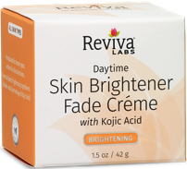
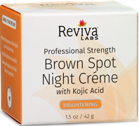
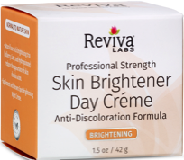
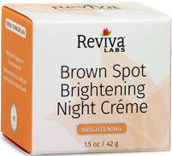
Brightening Collection
Target Consumer/Product Benefits
Day Crèmes
Daytime Skin Brightener Fade Crème* – MSRP $19 #587
Formulated for brown spots & other skin discolorations with Mulberry, Lime and Kojic Acid (2%)
Supplement with Brown Spot Night Crème for accelerated results
Skin Brightener Day Crème*–
MSRP $19 #581
Reduces the appearance of skin discoloration with precise blend of Mulberry, Lime & Hydroquinone (1%)
Supplement with Brown Spot Brightening Night Crème
*Notice: Patch test for sensitivity on the underside of the arm. This product is not recommended for use on children under 12 yrs. Do not use on eye area or over cuts or irritations. Sunscreen should be applied daily.
Night Crèmes
Brown Spot Night Crème with Kojic Acid* – MSRP $18 #586
Quickly diminishes appearance of dark spots/skin discoloration with Kojic acid
A natural oil base to aid absorption of Kojic Acid (2%)
Brown Spot Brightening Night Crème*
MSRP $13.20 #579
Helps reduce the appearance of skin discoloration with Hydroquinone (2%)
With consistent use each evening on face, hands or body, you may start to see discoloration diminishment in 4 wk. or sooner
Notes:
What Else You Should Know
Kojic Acid – sourced from fungi and rice fermentation and used as a skin lightening agent. When used in skin creams, it inhibits the formation of an amino acid called tyrosine which is needed to produce melanin. By inhibiting epidermal melanin production, kojic acid can have a lightening effect.
Hydroquinone – a skin-lightening agent. Hyperpigmentation is caused by increased presence of melanocytes generally due to inflammation. By controlling melanocytes, hydroquinone helps skin become more even toned. It does not affect redness.

Slide 8
Brightening Collection
Key Ingredients
Kojic Acid – sourced from several different types of fungi and used as a skin lightening agent. When used in skin creams, it inhibits and prevents the formation of an amino acid called tyrosine which is needed to produce melanin, the pigment that affects skin, hair and eye color. By inhibiting melanin production, kojic acid can have a lightening effect.
N-Hydroxysuccinimide (Haloxyl) and Chrysin– work together to activate the elimination of dark pigments responsible for dark circles and reduce inflammation to help eliminate under eye puffiness.
Palmitoyl oligopeptide & Palmitoyl tetrapeptide-7 – a synergistic combination of two active peptides that work to stimulate the synthesis and replenishment of the skin’s matrix or structural framework. This can lead to wrinkle reduction, skin firming and elasticity.
Alpha Arbutin – provides antioxidant protection and brightens uneven skin tone by blocking tyrosinase activity to help reduce over production of melanin. Derived from plants: bearberry, pear, blueberry.

Slide 9

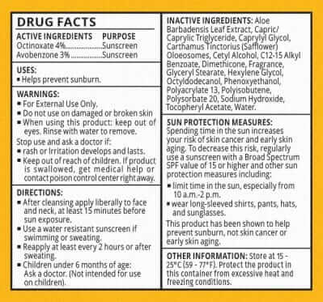
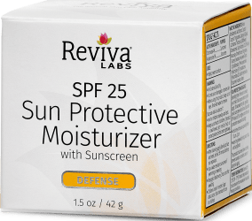
Defense Collection
Target Consumer/Product Benefits
Our Defense Collection works to protect the skin
against environmental damage. Anytime you’re out
doors, your skin needs extra protection.
SPF 25 Sun Protection Moisturizer Benefits
Everyday SPF 25 UV defense
Sheer, quick absorbing, greaseless formula
Moisturizes as it combats environmental damage
due to heat or cold
MSRP $20

Slide 10
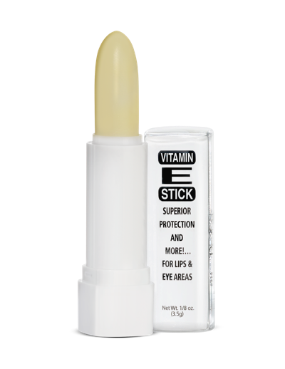
Reviva Labs Skin Care
Vitamin E-Stick
With SPF 15
Lip balm with Vitamin E and Allantoin in a natural beeswax base.
Moisturizes and soothes chapped, dry and cracked lips while protecting against UVA/UVB rays and wind damage.
Can apply over or under lipstick.
Translucent coverage ideal for women and men!
Our Vitamin E Oil E-Stick has been designed to naturally protect your lips which are vulnerable to drying and cracking or burning. But it can also be used under eyes, on cheeks, or any place that’s exposed to the sun or drying environments.
It’s natural beeswax base and soothing formula containing soy, Vitamin E and Allantoin will help to rehydrate dry, cracked lips while healing and soothing.
Directions: Apply to lips or under eyes for moisture and sun protection.
MSRP $5

Slide 11
Products that
Nourish and Rejuvenate

Slide 12
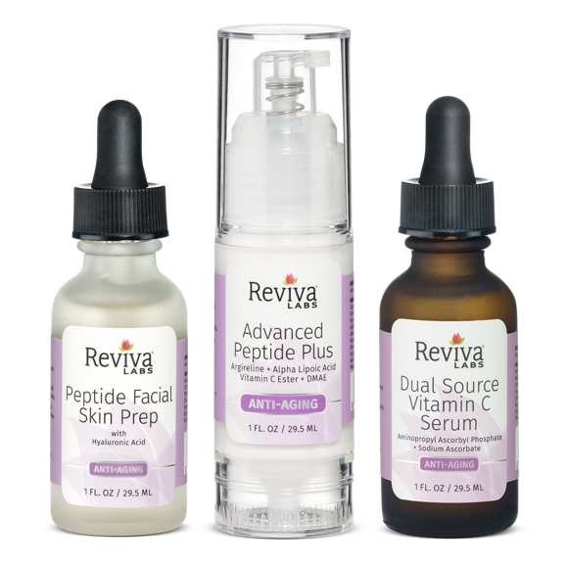
Anti-Aging
Anti-Aging Trio
Reviva Labs Anti-Aging Trio
The first of our new targeted multi-product protocols
1. Peptide Facial Skin Prep
2. Advanced Peptide Plus
3. Dual Source C Serum
A Multi-Product Layering Protocol
While Reviva’s skin care offers many ‘stand alone’ anti-aging items, our new Anti-Aging Trio takes a layered approach to fighting off the effects of environmental damage.
Effective on their own, but more powerful together, this three-step protocol will has skin looking and feeling younger and healthier in no time.

Slide 13
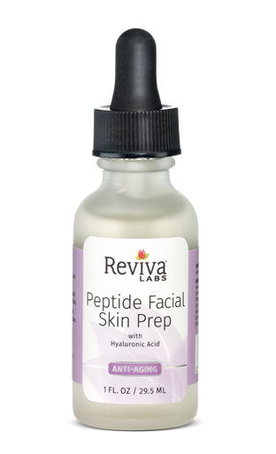
Anti-Aging
Peptide Facial Skin Prep with Hyaluronic Acid
Benefits
A lightweight gel serum that energizes as it restores.
Moisturizes, restores & energizes w/Hyaluronic Acid & Argireline, a peptide, thought to have a similar action to Botox. It works to relax the muscles the near the top of skin, helping to diminish the look of fine lines and wrinkles
Restores & rebalances minerals essential to healthy skin - Hawaiian Seaweed Extract Mineral Complex: Magnesium, Calcium, Potassium, Phosphorous, Sodium, Iron, Manganese, Zinc, Copper
Energizes skin cells and helps absorption of all follow up items
What are peptides?
Naturally occurring amino acids and building blocks of proteins like collagen. As skin ages, the natural supply of collagen decreases contributing to fine lines & wrinkle development. Applying topical peptides in conjunction with moisture binding Hyaluronic Acid, has shown to help stimulate skin cell growth and repair.
314

Slide 14
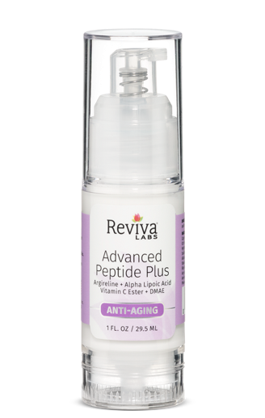
Anti-Aging
Advanced Peptide Plus
Argireline + Alpha Lipoic Acid + Vitamin C Ester + DMAE
Benefits
A creamy serum that provides a smoother, more youthful glow with antioxidants, peptides and skin brightening
Quickly reduces the appearance of fine lines & wrinkles
Helps repair & prevent damaged skin
Aged skin immediately appears tightened & firmed
Proven Effect Ingredients
10% Argireline – a peptide, relaxes muscles near the top of skin, helps diminish the look of fine lines & wrinkles
Alpha Lipoic Acid – a powerful antioxidant, protects entire cell from free radical damage and helps reduce inflammation.
DMAE – Helps tighten skin, smooth fine lines, enhances effects of Vit C, E & Alpha Lipoic Acid
Vitamin C Ester – a fat-soluble form of Vit C, improves elasticity, may help reduce appearance of hyperpigmentation, brightens
While results are immediately visible, daily use will provide cumulative benefits, diminishing the appearance of fine lines and wrinkles and hyperpigmentation.
313
Notes:
What Else You Should Know
Ingredient questions we sometimes get:
Glycerin – is Palm Oil (plant based)
Collagen – is animal sourced
Squalene – is sourced from olives

Slide 15
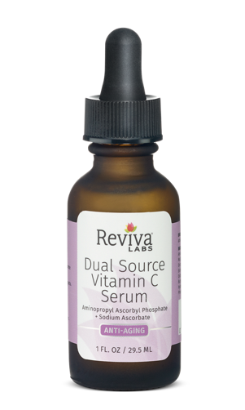
Anti-Aging
Dual Source Vitamin C Serum
Aminopropyl Ascorbyl Phosphate + Sodium Ascorbate
Benefits
A potent, lightweight gel serum that helps to encourage the skin’s restorative abilities, corrects existing environmental damage while combating future damage.
Helps repair environmental skin damage.
Two forms of Vitamin C work together to promote collagen synthesis.
Reduces appearance of dark/age spots.
Why two forms of Vitamin C?
Aminopropyl Ascorbyl Phosphate (3-AAP) & Ascorbic Acid are potent yet gentle, water soluble derivatives of Vitamin C. According to research, Vitamin C has been shown to neutralize free radicals and stimulate DNA repair*.
Studies suggest that Vitamin C serums might correct age associated structural changes, or photodamage, that can accumulate over years. As skin ages, regularly applying Vitamin C is one of the most effective ways to boost collagen synthesis and slow its degradation to help maintain healthy, younger-looking skin.*
*truthinaging.com/review/get-to-know-your-vitamin-c, lpi.oregonstate.edu/mic/health-disease/skin-health
233

Slide 16
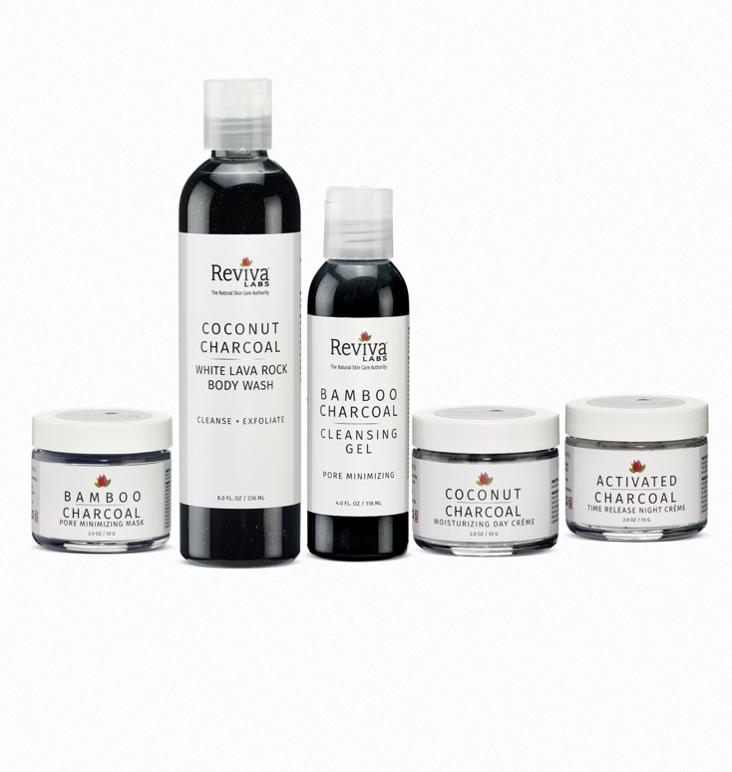
Specialty Skincare
A Complete Charcoal Skin Care Regimen
Detoxify, Moisturize, and Pore Minimize
Our five charcoal products will help refresh, rejuvenate, moisturize and detoxify your skin from your head to your toes.
Reviva’s new charcoal line consists of:
Bamboo Charcoal Pore Minimizing Mask - cleanses and exfoliates
Bamboo Charcoal Pore Minimizing Cleansing Gel - gentle deep cleansing
Coconut Charcoal & White Lava Body Wash - all-over body cleansing
Coconut Charcoal Moisturizing Day Crème - soothe, firm, and tone
Activated Charcoal Time Release Night Crème – detoxifies heals with Activated Charcoal, Tea tree and more

Slide 17
Reviva Labs Skincare Collections
Problem & Solutions
Problem | Solutions
Fine Lines & Wrinkles | Firming Collection | Anti-Aging Trio | Hyaluronic Acid Serum | Light Skin Peel Mild Exfoliant SPF 25 Sun Protective Moisturizer
Uneven, dull skin tone | Brightening Collection | Anti-Aging Trio |  | Light Skin Peel Mild Exfoliant SPF 25 Sun Protective Moisturizer
Dark Spots, discoloration | Brightening Collection | Anti-Aging Trio |  | Light Skin Peel Mild Exfoliant SPF 25 Sun Protective Moisturizer
Rough texture, flakiness, dehydrated, sensitive | Hydrating Collection | Anti-Aging Trio |  | Light Skin Peel Mild Exfoliant SPF 25 Sun Protective Moisturizer
Lack of firmness/tone, wrinkles | Firming Collection | Anti-Aging Trio | Collagen Serum & Collagen Night Crème | Light Skin Peel Mild Exfoliant SPF 25 Sun Protective Moisturizer

Slide 18


Natural Skin Care For All Skin Types

